Slide 1



New York City Shooting Incident
Data Analysis
Willian Botelho
Notes:
Hello! My name is Willian Botelho, and it's a great pleasure to be here with you. Thank you for attending my presentation. I promise to be brief and objective.

Slide 2




TRANSFORM
CONCLUSION
DATASET
VISUALIZATIONS
Notes:
Today's proposal is to follow this summary:
Dataset
Transformations
Visualizations
Conclusion

Slide 3
DATASET

Slide 4




DATASET
TIME RANGE
DEMOGRAPHIC INFORMATION
UPDATE AND REVIEW
DATASET UTILITY
Notes:
The dataset covers the period from January 2006 to December 2023, totaling 18 years of data.
The data is updated quarterly and reviewed by the NYPD’s Office of Management Analysis and Planning before being made available to the public.
The dataset includes columns with demographic information such as age, gender, race, neighborhood, and location of the incident, which leads to political and social discussions, as well as public safety issues.
Finally, the dataset is very complete, with few missing lines and no discrepant entries, such as incidents in absurd locations.

Slide 5
TRANSFORM
CONCLUSION
DATASET
VISUALIZATIONS

Slide 6
TRANSFORM

Slide 7




TRANSFORM
LOAD DATA
PERFORM INITIAL CLEANING
CHECK FOR MISSING DATA
Notes:
Since the dataset presented few problems, this preparation phase was quite facilitated. I followed this routine: loaded the data, did an initial cleaning, and checked for missing data.

Slide 8
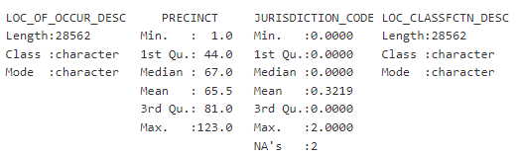
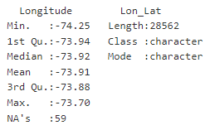
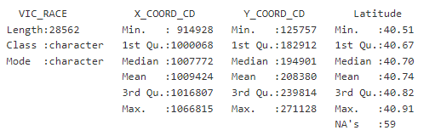
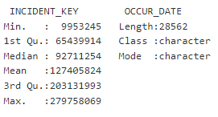
TRANSFORM
Notes:
There were some missing items, as we can see here.

Slide 9
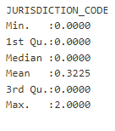
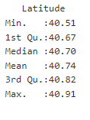
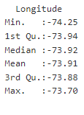

TRANSFORM
OTHER TRANSFORMATIONS
CONVERT VARIABLES DATA AND TIME
CONVERT VARIABLES TO FACTOR AND LOGICAL TYPES
REMOVING UNNECESSARY COLUMNS
SMALL AMOUNT OF MISSING DATA
ROWS
Notes:
After the transformations, there are no more missing items.
Considering that the missing data was minimal, I preferred to exclude these lines.
I also converted date and time variables that were in string format and adjusted variables to factors and logical types.
I removed unnecessary columns to make the processing faster, which is a good practice

Slide 10
TRANSFORM
CONCLUSION
DATASET
VISUALIZATIONS

Slide 11
VISUALIZATIONS

Slide 12
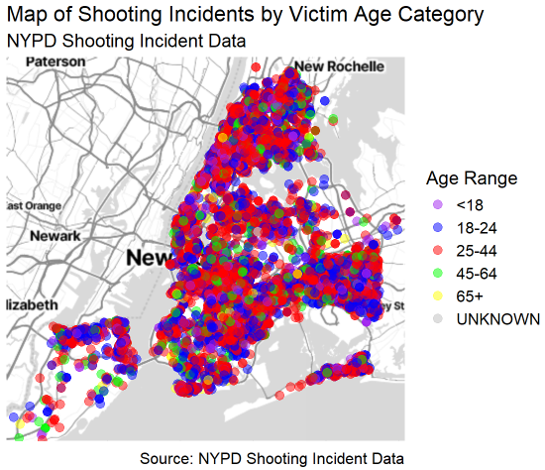
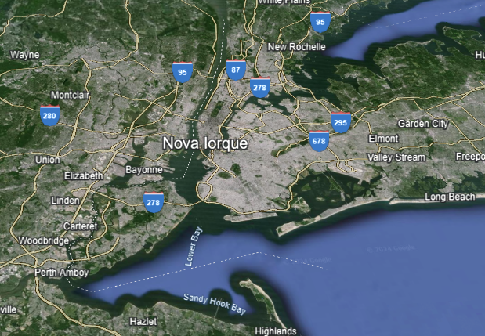
VISUALIZATIONS
Notes:
Here we have a chart of incidents by age range on the left and an image of the New York area on the right. The red concentration indicates that the 25 to 44 age range is the most affected.

Slide 13
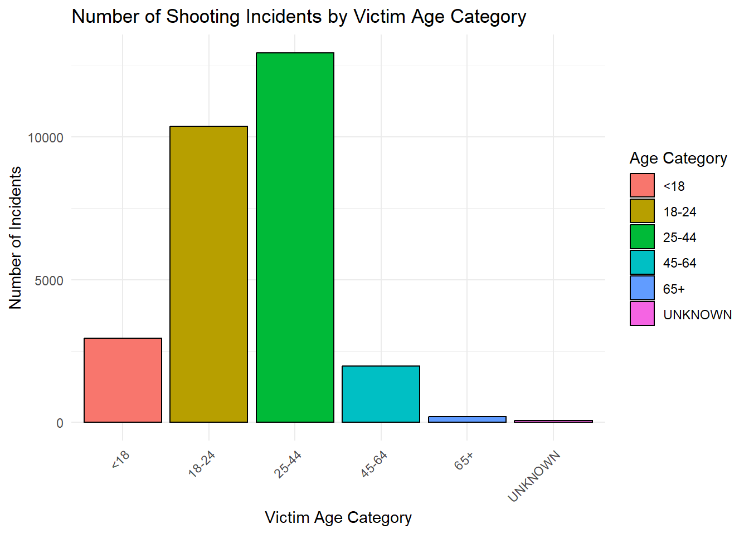
VISUALIZATIONS
1ST AGE MOST AFFECTED: 25 – 44
2ND AGE MOST AFFECTED: 18 – 24
Notes:
This chart confirms that the most affected age range is between 25 and 44 years, followed by 18 to 24 years.

Slide 14
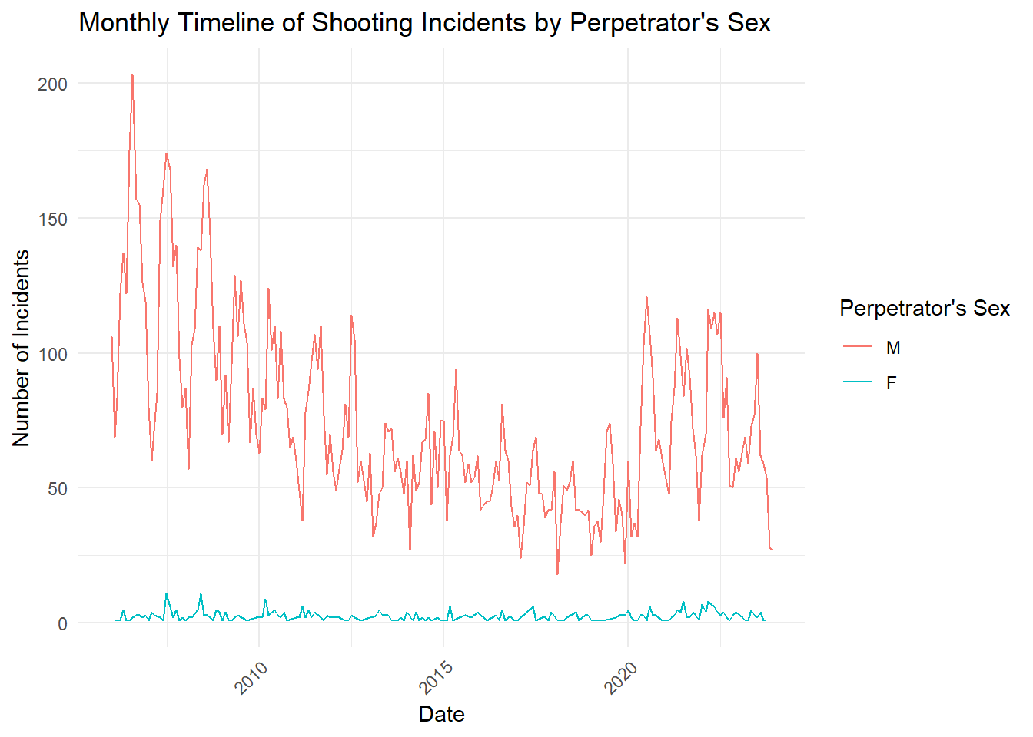
VISUALIZATIONS
PREDOMINANCE OF MALES AS PERPETRATORS
THERE HAS BEEN A TREND OF DECLINING INCIDENTS
STABLE LEVEL OVER THE YEARS, WITH SLIGHT VARIATIONS
THE PRESENCE OF HIGHER PEAKS
Notes:
We can see a clear predominance of males in the incidents.
There was a downward trend in shootings from 2009 to 2015, followed by stabilization until 2020.
And also, we can see the presence of high peaks.
This may be due to factors such as the COVID-19 pandemic or public policies implemented. It is an opportunity for discussion!

Slide 15
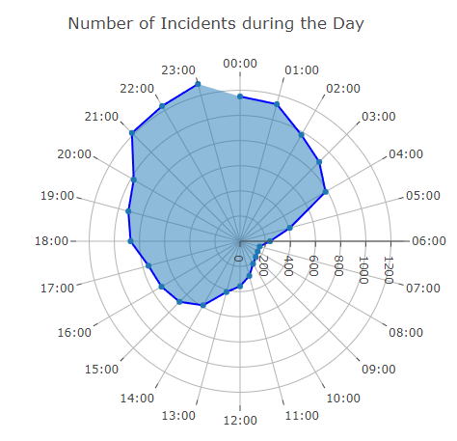
VISUALIZATIONS
PEAK INCIDENTS: 21:00-23:00
LOW INCIDENTS: 05:00-13:00
INCREASE BEGINS: 18:00
EVENING BEHAVIOR IMPACT
POST-WORKDAY EXPOSURE
Notes:
In the radial chart, we observe incident peaks between 9 PM at 11 PM, with low incidence between 5 AM at 1 PM. Incidents seem to begin increasing from 6 PM, reflecting people's nighttime behavior.

Slide 16
TRANSFORM
CONCLUSION
DATASET
VISUALIZATIONS

Slide 17
CONCLUSION

Slide 18





CONCLUSION
VALUABLE TOOL: ASSISTS GOVERNMENT SECURITY POLICIES.
NEIGHBORHOOD ANALYSIS: AFFLUENT VS. LESS PRIVILEGED CRIME RATES.
DATA REVIEW: POTENTIAL ANALYTICAL BIAS.
BIAS INVESTIGATION: GENDER AND RACE ANALYSIS.
OBJECTIVE ANALYSIS: AVOID POLITICAL/SOCIAL BIASES.
Notes:
In conclusion, the dataset is a valuable tool for implementing security policies and brings transparency regarding the deployment of police resources in the region.
I did not analyze this, but are neighborhoods with social differences more protected? From the map, it seems not.
Regarding the review by the NYPD’s Office of Management Analysis and Planning, there is potential for bias. Data review by third parties can introduce manipulations, especially during election periods to favor public managers.
Gender and race issues can also introduce bias and should be evaluated carefully to avoid divisions and focus on solutions.
Reducing bias is possible by being objective in the analysis, avoiding political and social influences.

Slide 19
BE BOULDER!
Notes:
Thank you!

